Slide 1

REVIEW OF RESEARCH PAPER
Fibre Reinforced Cement-Based (FRC) Composites after Over 40 Years of Development in Building and Civil Engineering (2008)
- By Andrzej M. Brandt
Published In:
Composite Structures / Building Materials Review
Review paper on evolution of FRC technology
NAME: M HEMA VARSHNI
YEAR & DEPT: 3rd Year Civil Engineering|
GUIDE NAME: Dr.Keerthana Kirupakaran

Slide 2
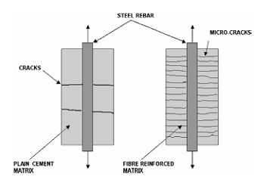
INTRODUCTION & HISTORY OF FRC
Why Fibre Reinforced Concrete?
Problems in Conventional Concrete
Concrete has:
low tensile strength
brittle behavior
poor crack resistance
Cracks reduce:
durability
service life
structural reliability
Historical Development:
The paper explains that fibers were used historically in:
clay bricks with straw
horsehair mortars
Modern FRC development started in: 1960s
Main Purpose of Fibers:
Fibers help in:
crack control
improving toughness
improving ductility
reducing brittle failure
Fig 1. Crack pattern in reinforced concrete (RC) and fibre reinforced concrete (FRC)
elements subjected to tension.

Slide 3
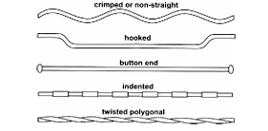
TYPES OF FIBERS & MODERN MATERIALS
Types of Fibers Used in FRC:
Steel Fibers
most common structural fibers
improve toughness and crack resistance
Glass Fibers
used in façade panels and thin sections
Synthetic Fibers
polypropylene
polyethylene
PVA fibers
Carbon Fibers
high strength and durability
Modern Cement-Based Materials:
The paper explains modern materials such as:
silica fume
fly ash
superplasticizers
high-performance concrete
These improve:
Strength
but also increase brittleness.
Hence fibers become more important.
Fig 2. Examples of deformed steel fibres, after Sujivorakul and Naaman.

Slide 4
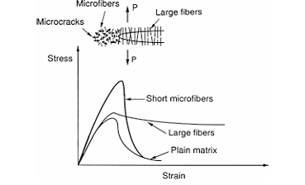
ADVANCED FRC COMPOSITES
Development of High-Performance FRC:
The paper discusses advanced composites such as:
ECC - Engineered Cementitious Composite
UHPC - Ultra High Performance Concrete
RPC - Reactive Powder Concrete
SIFCON - Slurry Infiltrated Fiber Concrete
Important Insight
Modern FRC is not only the stronger concrete
It is:
smarter
tougher
more durable
crack resistant
Important Characteristics
These materials show:
very high strength
improved ductility
strain hardening behavior
multiple cracking
Fig 3. Structures of long and short fibres controlling the crack propagation; after
Betterman et al.

Slide 5
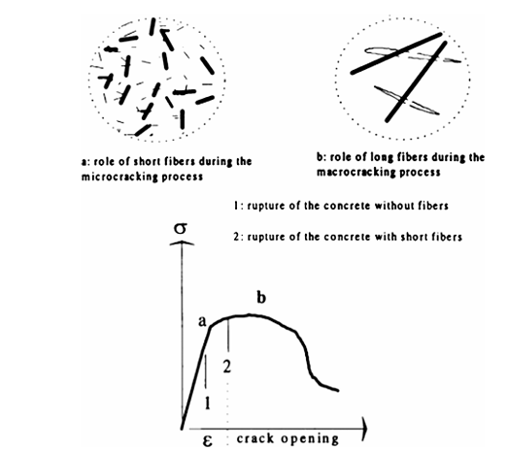
MECHANISM OF FRC BEHAVIOR
How Fibers Improve Concrete Behavior
Main Mechanism
Fibers bridge cracks after cracking begins.
They:
transfer tensile stress
resist crack widening
absorb energy through pullout
Important Concepts
Conventional Concrete
sudden brittle cracking
single dominant crack
FRC
multiple fine cracks
gradual failure
higher toughness
Strain Hardening Behavior:
Some advanced FRC materials:
continue carrying load after cracking
show strain hardening response
This is a major advancement in modern FRC.
Fig 4. Structure of short and long fibres controlling microcracks and its influence on the stress– crack opening curve

Slide 6
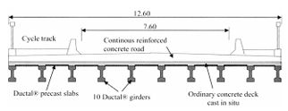
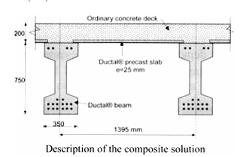
APPLICATIONS OF FRC
Engineering Applications of FRC:
The paper discusses applications in:
1. Structural Engineering
  bridge beams
  precast elements
  seismic structures
2. Pavements & Floors
  industrial flooring
  airport pavements
3. Tunnel Engineering
  shotcrete linings
  underground structures
4. Special Structures
  blast resistant structures
  impact resistant structures
Important Benefit:
Fibers help reduce:
crack width
reinforcement congestion
maintenance requirements
Fig 5. Cross-section of the bridge deck in Bourg-lès-Valence (France) made with FRC, Vf = 3%, after Behloul.
Fig 6. Cross-section of prestressed FRC bridge beams without mild reinforcement, Vf = 3%.

Slide 7
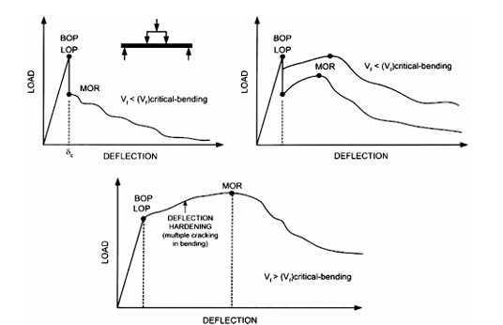
MAJOR FINDINGS, MODERN RELEVANCE & CONCLUSION
3. Advanced FRC materials show:
strain hardening behavior
multiple cracking
improved durability
Examples:
ECC
UHPC
HPFRCC
SIFCON
4. Modern FRC has major engineering applications
Used in:
bridge structures
tunnel linings
industrial flooring
pavements
blast resistant structures
Limitations Discussed in the Paper
Despite excellent performance, large-scale implementation is still limited due to:
high material cost
workability problems
lack of universal design standards
difficulty in fiber distribution
Major Findings of the Paper:
1. FRC technology evolved significantly over 40 years
From:
simple crack-control material
to
advanced structural composite.
2. Fibers mainly improve:
toughness
crack control
ductility
energy absorption
The primary mechanism is:
crack bridging and fiber pullout resistance.
Final Conclusion
The paper demonstrates how fiber reinforcement transformed concrete from a brittle material into a high-performance damage-tolerant composite.
The review also highlights the future importance of:
  high-performance cement composites
  fracture-resistant concrete systems
  advanced structural applications of FRC.
Fig 7. Typical load-deflection response curves of fibre reinforced cement composites, after Naaman.

